Slide 1
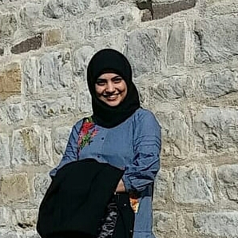
Iffat Jamil
Educational Background:
In 2nd semester of Digital Engineering
B.E in Electronics Engineering
Skills:
Served as Customer Facing Technical resource in a private firm
Programming Language: Java
Personal Motivation:
To learn App development skills
Implement and enhance my java skills
Enhance my interpersonal and communication skills

Slide 2
For Blog
As a student of Informatics department, it is crucial to have sufficient programming skills. I hope this subject will not only enhance my interpersonal and communication skills but also allow me to implement and practice some of the main and basic concepts of JAVA and App development.

